Slide 1
Docker and Containerization
Pranay Shahare

Slide 2
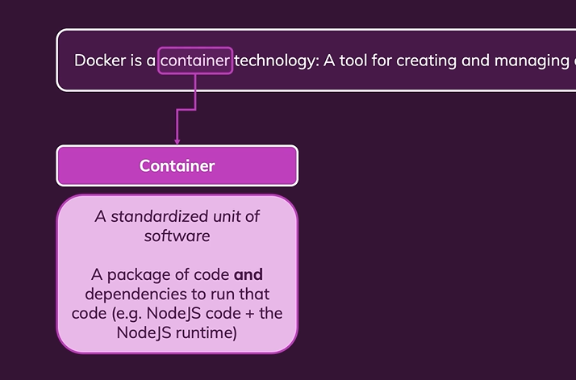
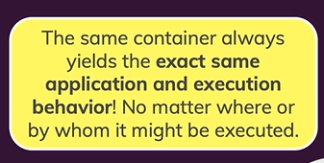
Container and its Main Advantage

Slide 3
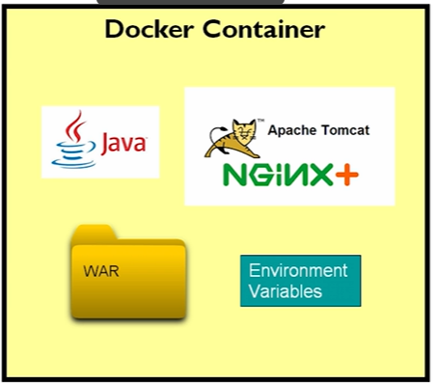
Container Example

Slide 4
Containerization Benefits
A container running on a developer’s laptop will run exactly the same as that container in your data center.
This consistency eliminates an entire class of development and deployment bugs.
Your team never has to worry about some developer writing code against a different version of PostgreSQL or Java than your application uses in production.
Your environment is identical everywhere it runs.

Slide 5
Docker

Slide 6
What is Docker?
Docker is a platform that allows you to “build, ship, and run any app, anywhere.”

Slide 7
‘Hello World’ in Docker

Slide 8
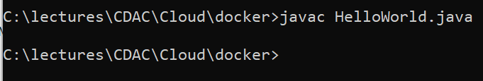
‘Hello World’ in Java using Docker
Create HelloWorld.java in C:\lectures\CDAC\Cloud\docker
public class HelloWorld {
public static void main(String[] args) {
System.out.println("Hello, World");
}
}
Compile: javac HelloWorld.java

Slide 9
Create Dockerfile
C:\lectures\CDAC\Cloud\docker\Dockerfile
FROM openjdk:11-jre-slim
ADD HelloWorld.class /
CMD ["java", "HelloWorld"]
Get the JRE
Add HelloWorld.class into the Docker image
Execute the HelloWorld class at the command prompt
CMD command in Docker specifies the instruction to be executed when a Docker container starts – it is NOT the Windows cmd command!
The main purpose of the CMD command is to launch the software required in a container.

Slide 10
Important points to avoid confusion!
We will see other examples where we have RUN and CMD commands in a Dockerfile – they are different
RUN command is used as a step in building a Docker image. Example below:
RUN javac Main.java
This step will help us in compiling a Java program, which we next want to execute
Now we can use the CMD command:
CMD ["java", "Main"]
To execute the Dockerfile: docker run …
So, RUN is an intermediate command, and a Dockerfile can have multiple RUN commands
Also, RUN inside Dockerfile and docker run are different commands with different purposes
CMD is the command that finally runs the file that we want to execute when we use a docker run command

Slide 11
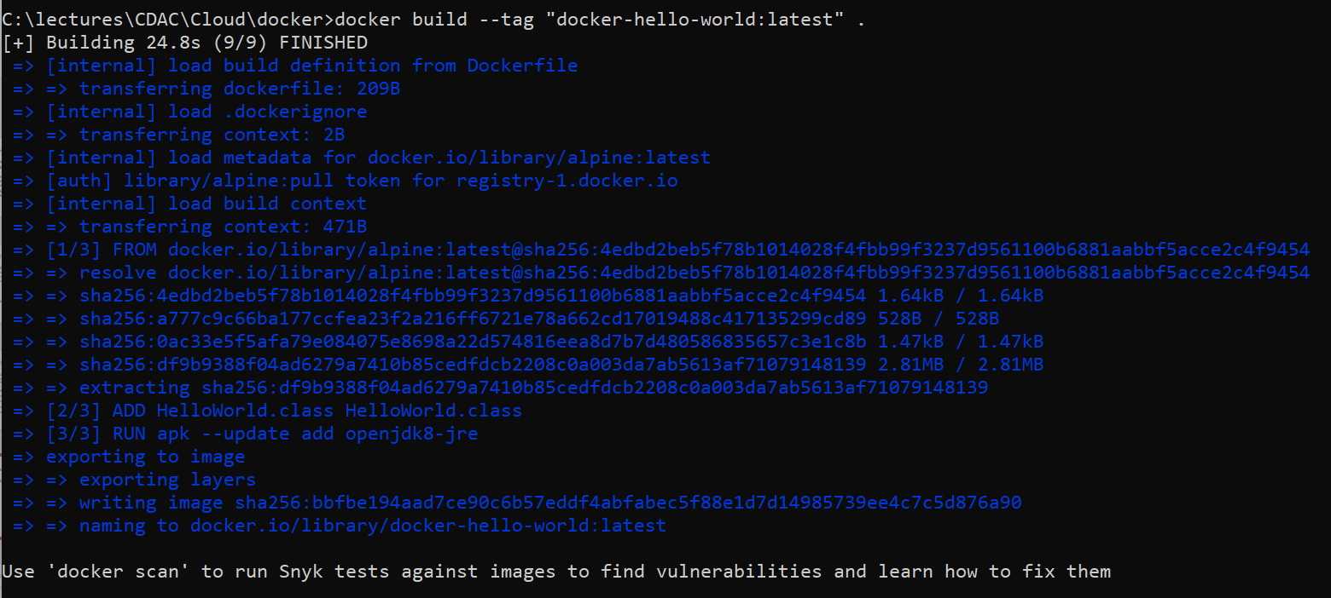
Build the Docker Image
docker build --tag "docker-hello-world:latest" .

Slide 12
Execute the Container
docker run docker-hello-world:latest

